Slide 1
College Algebra
Acosta/Karwowski

Slide 2
Unit 2 -a
Non-linear functions

Slide 3
Chapter 3
Nonlinear functions

Slide 4
Analyzing functions
Analyzing a function means to learn all you can about the function using tables, graphs, logic, and intuition
We will look at a few simple functions and build from there
Some basic concepts are:
increasing/decreasing intervals
x and y intercepts (zeroes and roots)
local maxima/minima
actual maximum/minimum
Even and odd functions

Slide 5
Maximum/ minimum
Maximum – the highest point the function will ever attain
Minimum – the lowest point the function will ever attain
Local(relative) maxima – is the exact point where the function switches from increasing to decreasing
Local (relative) mimima – the exact point where the function switches from decreasing to increasing

Slide 6
Example
Find y-intercept and the zeroes
Find relative maxima and minima
Find absolute maximum and minimum
Domain/range

Slide 7
(Cover only if extra time)Using technology to find intercepts
When you press the trace button it automatically sets on the y – intercept
Under 2nd trace you have a “zero” option. The x – intercepts or the x-coordinate of the intercept is often referred to as the zero of the function – this option will locate the x-intercepts if you do it correctly – the book explains how
Easier method is to enter y = 0 function along with your f(x). This is the x axis. You have created a system. Then use the intersect feature (#5) You do need to trace close to the intercept but you then enter 3 times and you will have the x- intercept

Slide 8
Examples(time permitting)
Find the y-intercept and the zeroes for the following functions using a calculator
f(x) = 3x³ + x² – x
g(x) = | 3 – x²| - 2

Slide 9
Even/odd functions: symmetry
when f(x) = f(-x) for all values of x in the domain f(x) is an even function
An even function is symmetric across the y – axis
When f(-x) = - f(x) for all values of x in the domain f(x) is an odd function
An odd function has rotational symmetry around the origin

Slide 10
Examples - graphically
Even odd neither

Slide 11
Examples - algebraically
Even / odd/ neither
f(x) = x² g(x) = x³ k(x) = x + 5
m(x) = x² – 1 n(x) = x³ – 1 j(x) = (3+x²)³
l(x)= (x⁵ – x)³

Slide 12
Average rate of change
Slope vs average rate of change
m = $\frac{y_{2}−y_{1}}{x_{2}−x_{1}}$
average rate of change = $\frac{f\left(x_{2}\right)−f(x_{1})}{x_{2}−x_{1}}$

Slide 13
examples
f(x) = 2x³ – 3x find the average rate of change for x = 1 and x = 2
Find average rate of change for the given pointd

Slide 14

Analyzing some basic functions
f(x) = x
g(x) = x²
h(x) = x³
k(x) = |x|
r(x) = 1/x
m(x) = $\sqrt{x}$
n(x) =$\sqrt[3]{x}$

Slide 15
5.2
Combinations and compositions

Slide 16
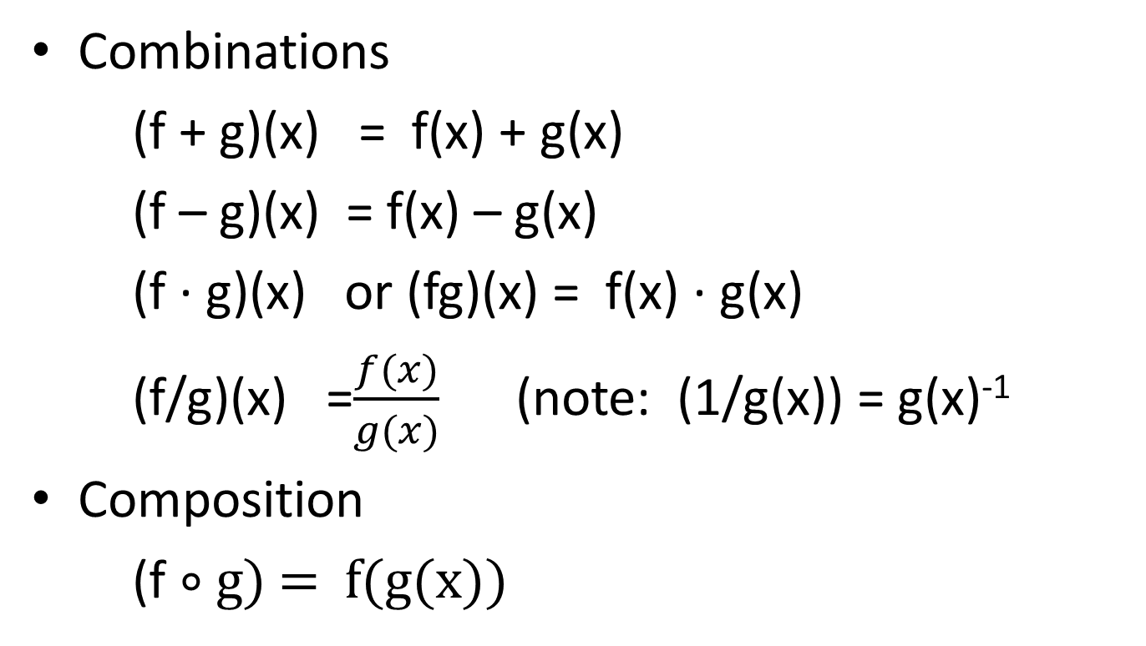
Notation
Combinations
(f + g)(x) = f(x) + g(x)
(f – g)(x) = f(x) – g(x)
(f · g)(x) or (fg)(x) = f(x) · g(x)
(f/g)(x) =$\frac{f(x)}{g(x)}$ (note: (1/g(x)) = g(x)⁻¹
Composition
(f ∘ g) = f(g(x))

Slide 17
composition
given f(x) = 2x + 5
What does f(3x) =
What does f(x – 7) =
What does f(x²)=
Essentially you are creating a new function.
The new function will take on characteristics of the old function but will also insert new characteristics from the variable expression.

Slide 18

Numeric examples
k(x) = 3x – 9 m(x) = (2x – 7)² n(x) =$\sqrt[3]{x−5}$
Find (k + m)(3)
(mn)(-3)
(k∘n)(32)

Slide 19
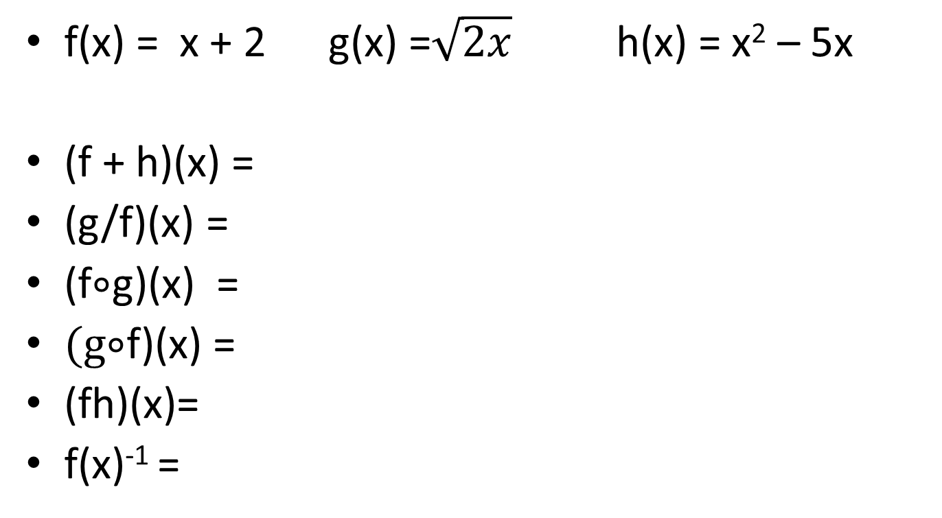
Examples
f(x) = x + 2 g(x) =$\sqrt{2x}$ h(x) = x² – 5x
(f + h)(x) =
(g/f)(x) =
(f∘g)(x) =
(g∘f)(x) =
(fh)(x)=
f(x)⁻¹ =

Slide 20
Examples reading graph
find (p + q)(5)
(pq)(-3)
(q∘p)(-6)
p(x)
q(x)

Slide 21
Difference quotient- an application of compositions and combinations
DQ - $\frac{f\left(x+h\right)−f(x)}{h}$
Ex - find the difference quotient for
f(x) = 3x² -7x

Slide 22
3-2
Linear compositions and combinations (transformations)

Slide 23
Function Families
When you create new functions based on one or more other functions you create “families” of functions with similar characteristics
We have 7 basic functions on which to base families
Transformations are functions formed by shifting and stretching known functions (linear composition/combination)
There are 3 types of transformations
translations - shifts left, right, up, or down
dilations – stretching or shrinking either vertically or horizontally
rotating - turning the shape around a given point
NOTE: we will not discuss rotational transformations

Slide 24
Translations
A vertical translation occurs when you add the same amount to every y-coordinate in the function
If g(x) = f(x) + a then g(x) is a vertical
translation of f(x); a units
A horizontal translation occurs when you add the same amount to every x- coordinate in the function
If g(x) = f(x – a) then g(x) is a horizontal translation
of f(x); a units

Slide 25


Determine the parent function and the transformation indicated- state the transformation in words- sketch both
f(x) = (x – 1)²
k(x) = |x| + 7
j(x) = $\sqrt{x+5 }−2$
m(x) = x³ + 9
$n\left(x\right)=\frac{1}{x}+4$
$m\left(x\right)=\frac{1}{x−3}$ + 4

Slide 26
Dilations/flips
A vertical dilation occurs when you multiply every y-coordinate by the same number – this is often called a scale factor - a “flip” occurs if the number is negative
visually this is like sticking pins in the x-intercepts and pulling/pushing
up and down on the graph
If g(x) = a(f(x)) then g(x) is a vertical dilation
a times “larger” than f(x)
A horizontal dilation occurs when you multiply every x – coordinate by the same number. A “flip” occurs if the number is negative.
If g(x) = f(ax) then g(x) is a horizontal dilation
$\frac{1}{a}$times the size of f(x)
visually this is like sticking a pin in the y- intercept and pushing/pulling sideways
Note: It is frequently difficult to tell whether it is vertical or horizontal dilation from looking at the graph

Slide 27

Determine the parent function and the transformation indicated and sketch both graphs
k(x) = (3x)² m(x) = 9x²
f(x) = - x³ g(x) = $−\frac{2}{3}|x|$
$h\left(x\right)=\sqrt{−2x}$ j(x) = $2\sqrt{x}$

Slide 28

Dilations with translations
k(x) = 4(x – 5)²
m(x) = (2x + 5)³
$g\left(x\right)=\sqrt{3x} −8$

Slide 29
Given a graph determine its equation

Slide 30
Given a graph determine its equation

Slide 31
Given a graph determine its equation

Slide 32
Chapter 3 section 3
Piece wise graphing

Slide 33
Sometimes an equation restricts the values of the domain
Sometimes circumstances restrict the values of the domain
Sometimes we choose to restrict domains

Slide 34
Piecewise functions
A function that is built from pieces of functions by restricting the domain of each piece so that it does not overlap any other.
Note: sometimes the functions will connect and other times they will not.

Slide 35
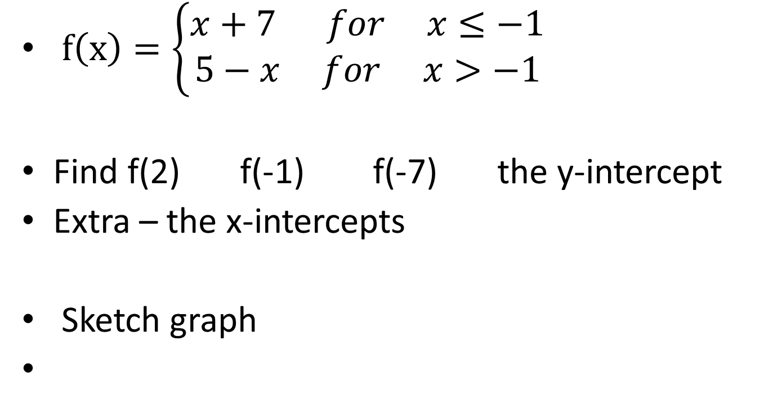
Examples
$f\left(x\right)=\left\{\begin{matrix}x+7 for x≤−1 \\ 5−x for x>−1\end{matrix}\right.$
Find f(2) f(-1) f(-7) the y-intercept
Extra – the x-intercepts
Sketch graph

Slide 36

$g\left(x\right)=\left\{\begin{matrix}{\left(x+2\right)}^{2} for x<1 \\ {−\left(x−2\right)}^{2} for x ≥1\end{matrix}\right.$
find g(1), g(-4) g(0)
Sketch graph

Slide 37
Chapter 3 - section 4
Absolute value functions

Slide 38
Absolute value equations/ inequality
From the graph of the absolute value function we can determine the nature of all absolute value equations and inequalities
f(x) = a has two solutions
x₁ and x₂
f(x) ≤ a is an interval [x_{1,} x₂
]
f(x)> a is a union of 2
intervals: (-∞, x₁)$∪$ (x₂,∞)
(note: the absolute value graph can
also be seen as a piecewise graph)
$f\left(x\right)=\left\{\begin{matrix}−x for x<0 \\ x for x≥0 \end{matrix}\right.$

Slide 39
Solving algebraically
Isolate the absolute value
Write 2 equations
Solve both equations – write solution
Ex. |2x - 3| = 2 |2x – 3|< 2 |2x – 3 |> 2
| 5 – 3x | + 5 = 12 4 - |x + 3| > - 12
| x – 2| = | 4 – 3x|

Slide 40
Summary of Objectives2
Maxima/minima
Recognize even and odd functions
Average rate of change
Recognize 7 basic nonlinear functions
Create functions by combinations and compositions
Understand transformations caused by linear combinations and compositions
Graph Piecewise functions
Solve Absolute value equations and inequalities

